Slide 1
The meeting will begin at 10:05am ET
Notes:
Enel X

Slide 2
Stakeholder Meeting 2022 Integrated Resource Plan Solar Solicitation
November 8, 2022
Notes:
Enel X

Slide 3
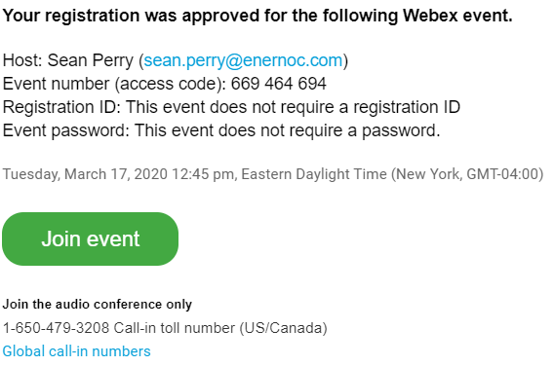
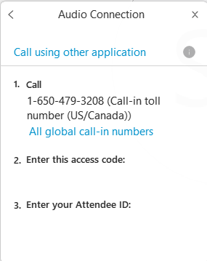
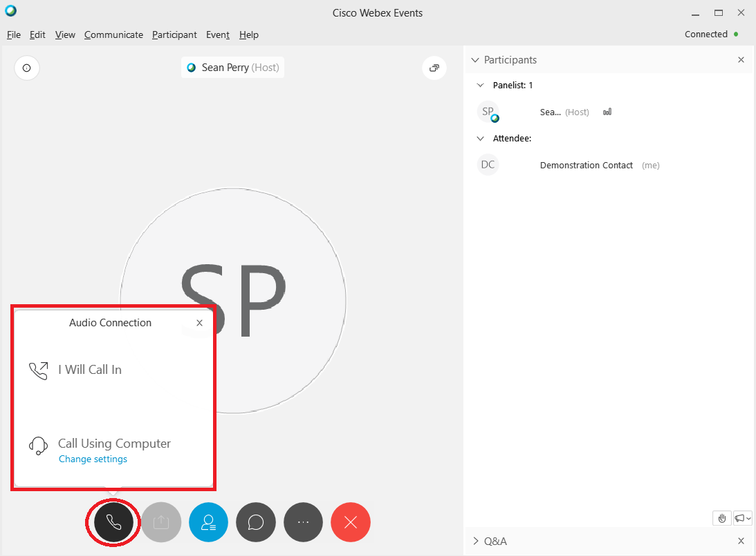
WebEx Access Instructions
Attendees should have pre-registered for the WebEx event using the link provided by Consumers Energy and/or Enel X.
To join the WebEx event, click the “Join event” button within the email received following WebEx registration.
Upon launching the WebEx application, you will be able to connect to the audio portion of the workshop by selecting either “I Will Call In” to dial-in using your phone or “Call Using Computer” to use your computer speakers and microphone.
Please note that you must enter both your access code AND attendee ID if dialing into the workshop and intending to speak.
All attendees will be muted by default upon connecting to the audio conference. Parties will be unmuted during the open Q&A windows and comments/suggestions window should they note intent to ask questions or provide comments.
Attendees may also submit questions and/or comments/suggestions for consideration via the WebEx Q&A or Chat interface.
Notes:
Enel X

Slide 4
Introductions
Consumers Energy
Beth Skowronski, Senior Business Consultant - Lead
Garrett Compton, Engineer I
Emily Walainis, Manager, Supply Contracts
Enel X
Chris Jewell, Renewable Energy Procurement Manager
Sean Perry, Director of Wholesale Government Energy Services
Brad Bury, Customer Insights, Wholesale & Renewables Procurement
Notes:
Enel X

Slide 5
Disclaimer
The information referenced in this presentation is available on www.ConsumersEnergyRFP.com and is in draft form and subject to change before launch.
Notes:
Enel X

Slide 6
Agenda
2022 Solicitation Overview
Changes from 2021 IRP Solicitation
Screening Requirements & Scoring Criteria
Timeline
Independent Administrator Overview
Instructions to Submit Comments / Questions
Notes:
Enel X

Slide 7
2022 IRP Solicitation Overview
The purpose of this RFP is to:
solicit offers for Consumers Energy to acquire solar generation projects and/or solar PPAs backed by projects located in that portion of the lower peninsula of the State of Michigan that is serviced by the Midcontinent Independent System Operator, Inc. (“MISO”) and
solicit offers for PPAs with PURPA QFs 5 MWac and below located within Consumers Energy’s service territory.
Proposals located within this region (MISO’s Local Resource Zone 7) are requested to support Consumers Energy’s IRP. With this RFP, Consumers Energy is seeking to acquire solar generation projects and PURPA QFs that provide the best cost and value to its customers, as determined by the Company’s Scorecard.
Notes:
Beth

Slide 8
2022 IRP Solicitation Overview (continued)
Consumers Energy is seeking competitive bids to acquire solar generation projects and/or PPAs backed by solar projects to support its Clean Energy Plan.
Selection: Proposals will be evaluated based on cost, value, and other non-price criteria as shown on the Scorecard (Appendix O); provisionally awarded proposals will be determined by the highest number of Scorecard points, COD timing, price and size of projects offered
Solicitation Capacity:
Maximum offer capacity per project not to exceed 600 MWac per PY (250 MWac preferred)
Maximum offer capacity in aggregate not to exceed 600 MWac per PY (500 MWac preferred)
Acceptable Contract Types:
Power Purchase Agreements (PPA)
Build-Transfer Agreements (BTA) – Milestone and Traditional
Development Asset Acquisitions (DAA)
Purchase and Sale Agreements (PSA)
*New* Portfolio combination of Utility Owned/PPA
Notes:
Beth

Slide 9
2022 IRP Solicitation Overview (continued)
Consumers Energy is seeking the following target capacities:
500 MWac for PY 2025
204 MWac for PY 2026
500 MWac for PY 2027
While the above reflects the Company’s 2021 IRP Proposed Course of Action as approved by the settlement agreement in that proceeding:
Projects awarded in this solicitation may exceed the target amounts depending on the amount of bids, the size of projects bid, cost and value, and variations in project CODs
The Company intends to award all of the target capacity for PY 2025, a large part for 2026 and some of the capacity for 2027
Notes:
Beth

Slide 10
Changes from 2021 Integrated Resource Plan Solicitation
 | 2021 IRP Solicitation | 2022 IRP Solicitation
Project Selection | Value Added Criteria | *New* Points-Based Scorecard
Project Types | Utility Owned and Power Purchase Agreements | Utility Owned and Power Purchase Agreements *New* Portfolio (Utility Owned and PPA combined)
Notes:
Beth

Slide 11
2022 IRP Solicitation: Screening Requirements
Screening Requirements | Solar Facility
Pre-Qualification | Required
Project Application Fee (non-refundable) | *New* Waived
Pre-Bid Security (refundable) | $1,500/MWac per unique MWac of capacity to be proposed
Max. Offer Capacity per project (per PY) | 600 MWac (250 MWac preferred); 5 MWac for PURPA QFs
Max. Offer Capacity in aggregate (per PY) | 600 MWac (500 MWac preferred); 600 MWac for PURPA QFs (250 MWac preferred)
Minimum Offer Capacity | 1 MWac; 0.15 MWac for PURPA QFs
Location | MISO Zone 7 ($≥$ 50 kV POI); Consumers Energy Electric Service Territory ($<$ 50 kV)
Interconnection Status | See next slide
Feasibility | No Solar Moratorium in Project Location
Site Control | >/= 75% secured
Technology | Solar Resources; Any QF technology for PURPA QFs
Technical Specifications | Utility Owned projects must meet required solar technical specifications
Projects that do not include both non-affiliate, third-party, verified production estimates and a report on fatal flaws or risks will not be eligible to participate in this RFP
Notes:
Beth

Slide 12
2022 IRP Solicitation: Screening Requirements Interconnection Status
For projects with COD on or before June 1, 2025, projects must have a completed engineering review (if interconnected with Consumers Energy), completed Definitive Planning Phase (“DPP”) Entry (if interconnected at transmission voltage) in DPP-2021-Cycle or earlier DPP Cycles, or show no materially adverse impact within the Interconnection Study for Surplus Interconnection Service requests process (if interconnected at transmission voltage), prior to the Proposal Due Date to be eligible to participate in this Solicitation.
For projects with COD from June 2, 2025 through June 1, 2027, projects must have submitted a request for engineering review (if interconnected with Consumers Energy), have a definitive plan to complete DPP Entry (if interconnected at transmission voltage) in DPP-2022-Cycle or earlier DPP Cycles, or show no materially adverse impact within the Interconnection Study for Surplus Interconnection Service requests process (if interconnected at transmission voltage), prior to the Proposal Due Date to be eligible to participate in this Solicitation.
Notes:
Beth

Slide 13
2022 IRP Solicitation: Scoring Criteria
Projects will be ranked based on score as determined by the Scorecard criteria
Winning proposals will be determined by the highest number of Scorecard points, amount of bids, the size of projects bid, and variations in project CODs
Evaluation based on Company’s Triple Bottom Line: People, Planet, and Michigan’s Prosperity
Scorecard (Appendix O) and Scorecard Guidance (Appendix N) are resources to support making scoring claims
Some rating items cannot be verified until project completion (e.g., Michigan Labor %, etc.):
Claims in these categories will require an attestation to be submitted to support commitment
Verification of claims will be made to determine adherence
A penalty of $1,400 per MW per Scorecard point will be levied if the commitment is not met prior to the project’s commercial operation date
Notes:
Garrett

Slide 14
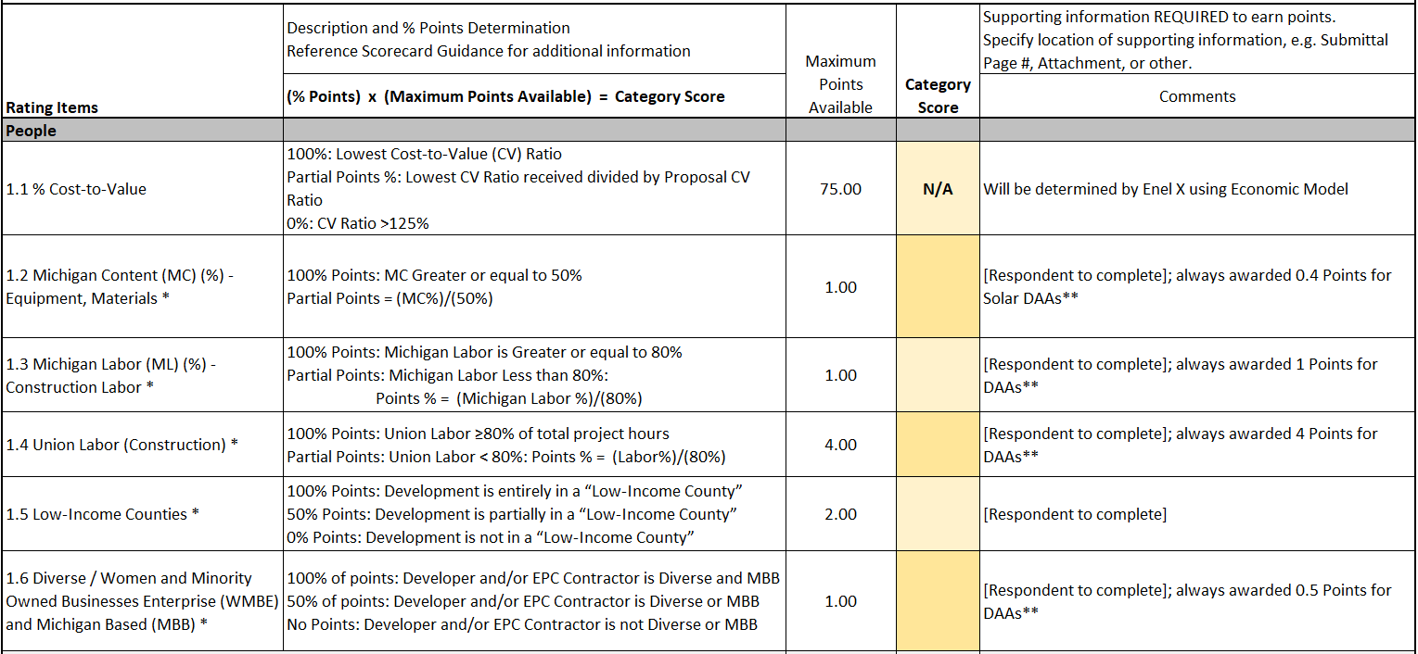
2022 IRP Solicitation: Scoring Criteria - People
New Items from the ‘21 IRP
* For all scorecard rating items that require a commitment (e.g., they cannot be verified at time of bid evaluation), a penalty of $1,400 per MW per Scorecard point will be levied if the commitment is not met
Notes:
Garrett

Slide 15
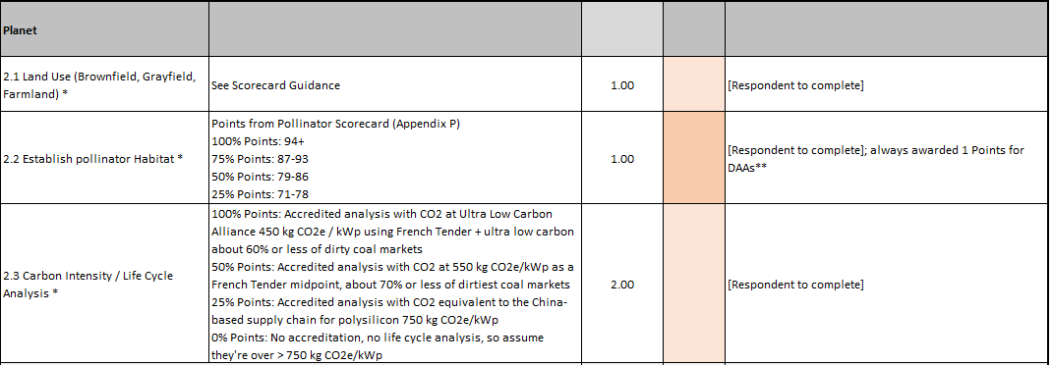
2022 IRP Solicitation: Scoring Criteria - Planet
New Items from the ‘21 IRP
* For all scorecard rating items that require a commitment (e.g., they cannot be verified at time of bid evaluation), a penalty of $1,400 per MW per Scorecard point will be levied if the commitment is not met
Notes:
Garrett

Slide 16
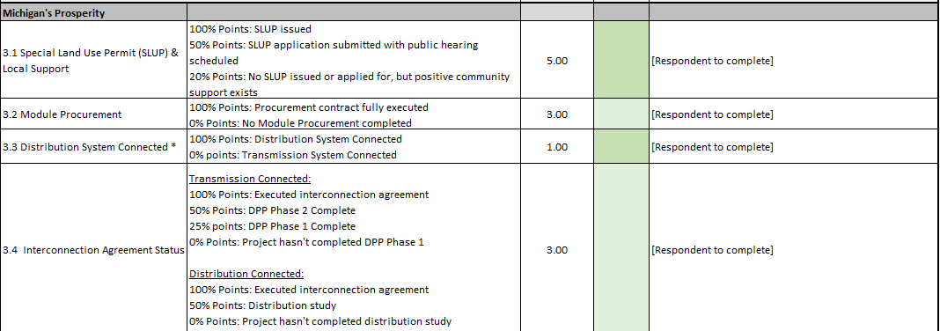
2022 IRP Solicitation: Scoring Criteria - Michigan’s Prosperity
New Items from the ‘21 IRP
* For all scorecard rating items that require a commitment (e.g., they cannot be verified at time of bid evaluation), a penalty of $1,400 per MW per Scorecard point will be levied if the commitment is not met
Notes:
Garrett

Slide 17
2022 IRP Solicitation: Timeline
Milestone | Date
Solicitation Issued | December 8, 2022
Pre-Bid Conference Held | 2:00 pm EPT, December 15, 2022
Respondent and Project Qualification Applications Due | 5:00 pm EPT, January 13, 2023
Respondent and Project Fees Due | 5:00 pm EPT, January 13, 2023
Binding Respondent Affidavits Due | 5:00 pm EPT, February 22, 2023
Pre-Bid Security Due | 5:00 pm EPT, February 22, 2023
Notices to Proceed Issued | February 24, 2023
Sealed PPA Bid Event Conducted on Solicitation Platform | March 1, 2023
Sealed BTA/Portfolio Bid Event Conducted on Solicitation Platform | March 2, 2023
Consumers Energy Proposal Evaluation Completion Target | March 24, 2023
Conditional Agreements Execution Target | July 2023
MPSC Submittal Target | August 2023
Notes:
Garrett

Slide 18
2022 IRP Solicitation: Stakeholder Feedback
While CE and Enel X welcome comments from Stakeholders on all the materials released and the process as described in today’s session, we also have a few specific topics for comment that we’d like to highlight:
The proposal launch date is December 8, 2022 and bid events are March 1 & 2, 2023. Please let us know if you have concerns regarding not having enough time to put together an RFP response.
Is the increased flexibility clear? (e.g., aggregate PPA & Utility Owned bids, COD MW targets v. maximums, etc.)
Comments on new non-price Scorecard categories.
Notes:
Garrett

Slide 19
Independent Administrator Role
19
Notes:
Enel X

Slide 20
Independent Administrator
Role Overview, Conflict of Interest Statement
Any communications related to this RFP or the Solicitation process must be submitted to Consumers Energy's Independent Administrator, Enel X, through the links provided on the Solicitation Website within the 'Questions' section.
Please note that Enel X is a distinct and independent operating company from Enel Green Power (a renewable energy developer). Enel X does not have a renewable energy development arm or ability/intent to participate within the Consumers Energy RFP process. While both separate entities share part of a common name and holding company, there are no overlapping components between each entity and absolutely no preferential treatment(s), reciprocal or otherwise, given between Enel X and Enel Green Power.
Enel X, as the Independent Administrator, does not, and will not share the sensitive information provided by respondents with affiliates of Enel or other Enel Group companies. Further, Enel X will conduct and manage all facets of the Consumers Energy RFP process with the utmost transparency while ensuring that all respondents are treated fairly, equitably, and without bias (real or perceived). Enel X takes both our partners’ and respondents’ confidentiality and the establishment of a level playing field for all respondents seriously and has detailed protocols to ensure that all confidential information remains confidential and that all administered RFPs afford equal opportunity to every respondent.
Enel X employees must observe an obligation of confidentiality and neutrality while performing Independent Administrator services, and may not disclose confidential information outside of Enel X (including employees of other companies of the Enel Group, respondents, other customers, etc.) or provide preferential treatment to any respondent. For this purpose, Enel X has established:
Physical separation of databases belonging to different companies within the Enel group;
Regulation of access to the Enel X Solicitation Website; and
Signature of a specific confidentiality and neutrality declaration by each Enel X employee providing these services in order to define a general duty of confidentiality and neutrality in the performance of their activities.
In addition to following protocols outlined within the RFP document regarding the treatment of confidential information, Enel X is also willing to establish non-disclosure agreements between its organization and Respondents.
20
Notes:
Enel X

Slide 21
Charter
Enel X, as the Independent Administrator for the IRP RFP solicitations, will support stakeholders through RFP development, independently and without bias administer fair and transparent solicitations, provide individualistic support to respondents, collect and score proposals, produce scored shortlists, and provide regulatory support post-solicitation.
21
Notes:
Enel X

Slide 22
Independent Administrator Deliverables
Primary Deliverables – Five Stage/Phase RFP Process
Preparation Phase
Review and provide comments to CEC VGP documents, materials
Attend stakeholder workshop and provide support to stakeholders
Draft solicitation advertisements
Solicitation Phase
Issue notice, solicitation, and launch solicitation website
Provide support to respondents, collect participation prerequisites
Evaluation Phase
Conduct initial screen of proposals, prepare initial evaluation results
Prepare final evaluation results and ranked short lists of proposals
Selection Phase
Field CEC award selections, identify potential affiliate transactions
Develop draft and final Independent Administrator reports
Approval Phase
Support inquiries from MPSC Staff regarding bid validation and confirmation of the fairness and transparency of the solicitation process
22
Notes:
Enel X

Slide 23
Instructions to Submit Comments / Questions
Thank you for your participation today!
Consumers Energy and Enel X teams are willing to take live questions at this time. Please note that your identity will be known if using this feature. Any questions the team cannot field immediately, will be responded via our formal Q & A process. Please use the raise hand function.
Please submit formal comments, suggestions, and questions via email at CECIA.enelxnorthamerica@enel.com by November 15, 2022. These questions will be provided to Consumers Energy without Respondent identifying information.
Based on the submittals, Consumers Energy will provide written clarifying Q&A on the website below prior to solicitation launch.
Materials presented today will be posted on the Company website: www.consumersenergy.com/electricpowernotices
Notes:
Enel X

